Slide 1
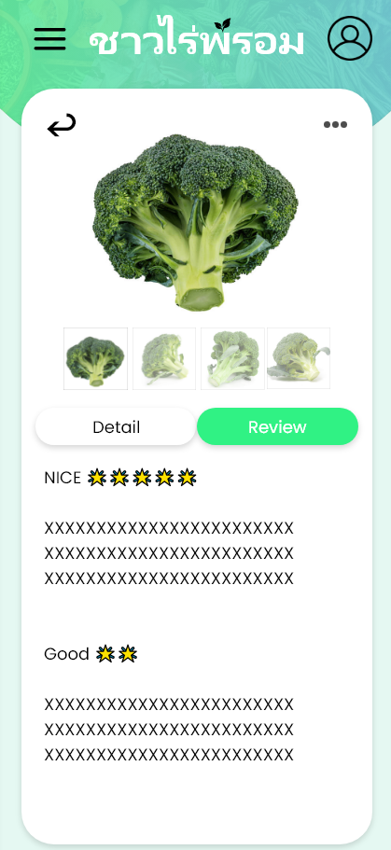
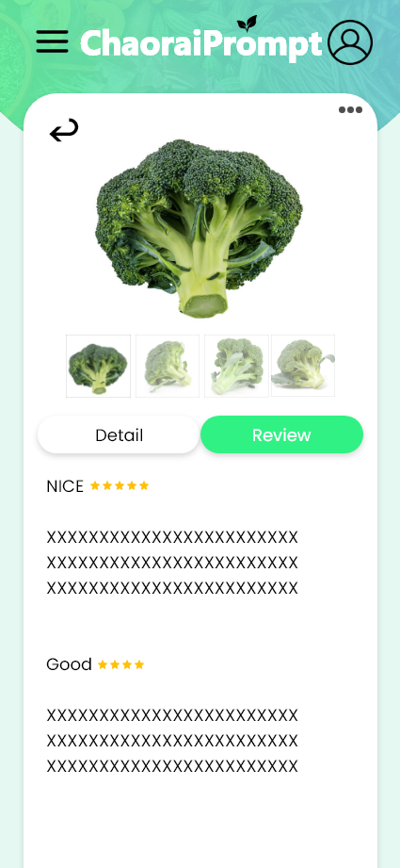
Usability Testing
Test whole features of the software start with user, farmer and admin features
Techniques: Think Aloud
Failure point: Some word are used incorrectly Color Palette of UI and icon of user

